Slide 1
INTERPROFESSIONAL APPROACH FOR ACHIEVING WHO’S 2025 GLOBAL NUTRITION TARGETS
DR GEETA APPANNAH, PHD (CANTAB)
DEPARTMENT OF NUTRITION AND DIETETICS
UNIVERSITI PUTRA MALAYSIA

Slide 2
Global Nutrition Targets 2025

Slide 4
Definition
Interprofessional collaboration (IPC)
When multiple healthcare workers from different professional backgrounds work together with patients, families, carers, and communities to deliver the highest quality of care. (WHO 2010)
Interprofessionality
The process by which professionals reflect on and develop ways of practicing that provides an integrated and cohesive answer to the needs of the client/family/population … involving the continuous interaction and knowledge sharing between professionals and is organized to solve or explore a variety of education and care issues while seeking the patient’s participation … (D’Armour & Oandasan, 2005, p. 9)

Slide 5
Principles of IPC
Patient and family centered
Community and population oriented
Relationship focused
Process-oriented but outcomes-driven
Integrated across the learning continuum
Applicable across professions
Sensitive to systems context

Slide 6
Benefits of IPC
Improved communication
Increased efficiency
Improve employee morale
Fosters creativity
Better problem-solving
Networking
Better clinical outcomes, cost-effectiveness, safety
Strengthened professional identity

Slide 7
Teams and Teamwork
Team
“Two or more people whose tasks are in some way interdependent
(i.e., individual efforts are dependent upon the efforts of other members) and who have a shared common goal” (Salas, 2015)
Teamwork
“Coordination, cooperation, and communication among individuals to achieve a shared goal” (Salas, 2015)
Team Training
“A set of tools and methods used to train a group of individuals on both task-related individual competencies and team competencies (Salas & Connon-Bowers, 2000)

Slide 8
EMERGING EVIDENCE

Slide 9
EMERGING EVIDENCE
Evidence for IPC
Collaborative practice strengthens health systems and improves health outcomes.
Health leaders who choose to contextualize, commit and champion interprofessional education and collaborative practice position their health system to facilitate achievement of the health-related Millennium Development Goals (MDGs).
Evidence clearly demonstrates the need for a collaborative practice ready health workforce, which may include health workers from regulated and non-regulated professions.

Slide 10
EMERGING EVIDENCE
Improved outcomes
A team-based approach to health-care delivery maximizes the strengths and skills of each contributing health worker. (Mickan SM. Evaluating the effectiveness of health care teams. Australian Health Review, 2005, 29(2):211-217.)
IPC can assist in recruitment and retention of health workers and possibly help mitigate health workforce migration. (Yeatts D, Seward R. Reducing turnover and improving health care in nursing homes: The potential effects of self-managed work teams. The Gerontologist, 2000, 40:358–363.)
Improved workplace practices and productivity
Improved patient outcomes
Raised staff morale
Improved patient safety
Better access to health-care
In both acute and primary care settings, patients report higher levels of satisfaction, better acceptance of care and improved health outcomes following treatment by a collaborative team.

Slide 11
EMERGING EVIDENCE
Collaborative practice can improve:
access to and coordination of health-services
appropriate use of specialist clinical resources
health outcomes for people with chronic diseases
patient care and safety
References:
Hughes SL et al. A randomized trial of the cost-effectiveness of VA hospital-based home care for the terminally ill. Health Services Research, 1992, 26:801–817.
Jansson A, Isacsson A, Lindholm LH. Organisation of health care teams and the population’s contacts with primary care. Scandinavian Journal of Health Care, 1992, 10:257–265.
Lemieux-Charles L et al. What do we know about health care team effectiveness? A review of the literature. Medical Care Research and Review, 2006, 63:263–300.

Slide 12
EMERGING EVIDENCE
References:
Holland R et al. Systematic review of multidisciplinary interventions in heart failure. Heart, 2005, 91:899–906.
Lemieux-Charles L et al. What do we know about health care team effectiveness? A review of the literature. Medical Care Research and Review, 2006, 63:263–300.
McAlister FA et al. Multidisciplinary strategies for the management of heart failure patients at high risk for admission. Journal of the American College of Cardiology, 2004, 44:810–819.
Mickan SM. Evaluating the effectiveness of health care teams. Australian Health Review, 2005, 29(2):211-217.
Morey JC et al. Error reduction and performance improvements in the emergency department through formal teamwork training: Evaluation results of the MedTeams project. Health Services Research, 2002, 37:1553–1581.
Naylor CJ, Griffiths RD, Fernandez RS. Does a multidisciplinary total parenteral nutrition team improve outcomes? A systematic review. Journal of Parenteral and Enteral Nutrition, 2004, 28:251–258.
Teamwork in healthcare: Promoting effective teamwork in healthcare in Canada. Ottawa, Canadian Health Services Research Foundation, 2006 (http://www.chsrf.ca/research_themes/pdf/teamwork-synthesisreport_e.pdf).
West MA et al. Reducing patient mortality in hospitals: the role of human resource management. Journal of Organisational Behaviour, 2006, 27:983–1002.
Yeatts D, Seward R. Reducing turnover and improving health care in nursing homes: The potential effects of self-managed work teams. The Gerontologist, 2000, 40:358–363.
Collaborative practice can decrease:
total patient complications
length of hospital stay
tension and conflict among caregivers
staff turnover
hospital admissions
clinical error rates
mortality rates

Slide 13
EMERGING EVIDENCE
In community mental health settings collaborative practice can:
increase patient and carer satisfaction
promote greater acceptance of treatment
reduce duration of treatment
reduce cost of care
reduce incidence of suicide
increase treatment for psychiatric disorders
reduce outpatient visits
References:
Jackson G et al. A new community mental health team based in primary care: a description of the service and its effect on service use in the first year. British Journal of Psychiatry, 1993, 162:375–384.
Malone D et al. Community mental health teams (CMHTs) for people with severe mental illnesses and disordered personality. Framework for Action on Interprofessional Education and Collaborative Practice Cochrane Database of Systematic Reviews, 2007, Issue 2. (Art. No.: CD000270. DOI: 10.1002/14651858.CD000270.pub2)
Simmonds S et al. Community mental health team management in severe mental illness: a systematic review. The British Journal of Psychiatry, 2001, 178:497–502.

Slide 14
EMERGING EVIDENCE
Terminally and chronically ill patients who receive team-based care in their homes:
are more satisfied with their care
report fewer clinic visits
present with fewer symptoms
report improved overall health
References:
Hughes SL et al. A randomized trial of the cost-effectiveness of VA hospital-based home care for the terminally ill. Health Services Research, 1992, 26:801–817.
Sommers LS et al. Physician, nurse, andsocial worker collaboration in primary care for chronically ill seniors. Archives of Internal Medicine, 2000, 160:1825–1833.

Slide 15
EMERGING EVIDENCE
Health systems can benefit from the introduction of collaborative practice which has reduced the cost of:
setting up and implementing primary health-care teams for elderly patients with chronic illnesses
redundant medical testing and the associated costs
implementing multidisciplinary strategies for the management of heart failure patients
implementing total parenteral nutrition teams within the hospital setting
References:
McAlister FA et al. Multidisciplinary strategies for the management of heart failure patients at high risk for admission. Journal of the American College of Cardiology, 2004, 44:810–819.
Naylor CJ, Griffiths RD, Fernandez RS. Does a multidisciplinary total parenteral nutrition team improve outcomes? A systematic review. Journal of Parenteral and Enteral Nutrition, 2004, 28:251–258.
Sommers LS et al. Physician, nurse, and social worker collaboration in primary care for chronically ill seniors. Archives of Internal Medicine, 2000, 160:1825–1833.

Slide 16
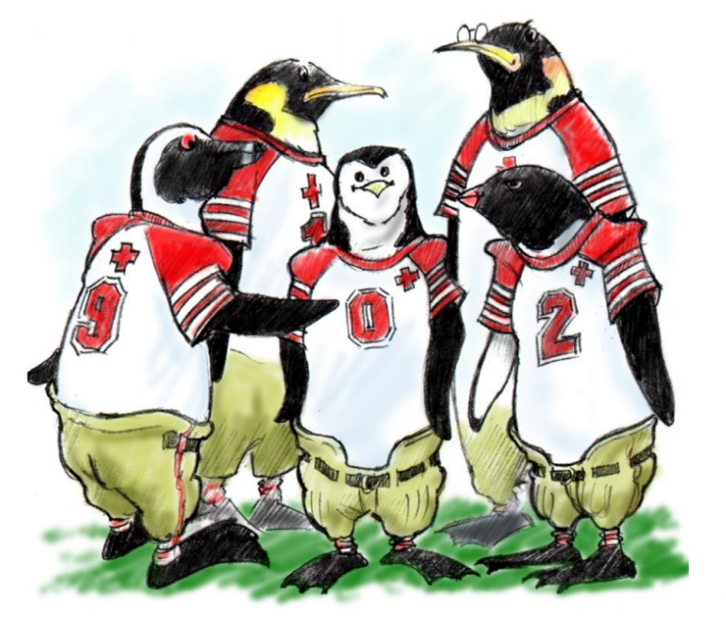
“It is no longer enough for health workers to be professional. In the current global climate, health workers also need to be interprofessional.”(WHO, 2010, p. 36)

Slide 17
Interprofessionality is not
Simply sharing electronic health records
Sole profession teams
Learners hearing a talk about another profession
Reporting out at interdisciplinary team meetings
Decision-making without client/patient input

Slide 18
Why now?
Demographic changes, aging population
Chronic health conditions – needing complex care
Technological advances
Patient safety & quality agenda
Workforce pressures & gaps

Slide 19
Change

Slide 20
Roles and Responsibilities
Know one’s own role and those of team members
Communicate team roles and responsibilities
Engage diverse healthcare professionals to meet the needs of patients
Use the full scope of knowledge, skills, and abilities of available health professionals and health care workers to provide safe, timely, efficient, effective and equitable care
Use respectful healthcare practices

Slide 21
Values & Ethics
Recognize and respect the unique cultures, values, roles/responsibilities and expertise of other health professions
Work in cooperation with those who receive care, those who provide care, and those who contribute to or support the delivery of prevention and health care services
Place the interests of patients and populations at the center of interprofesional health care delivery

Slide 22
Communication
Use respectful and appropriate communication in all situations
Organize and communicate information with patients, families and health care team members in a form and format that is understandandable, avoiding jargon
Listen actively and encourage ideas and opinions of team members

Slide 23
Teamwork
Work with others to deliver patient-centered, community responsive care
Engage when possible in shared patient-centered problem solving
Integrate knowledge and experience of other professions to inform effective/ethical decisions
Apply leadership and facilitate practices that support collaboration and team effectiveness
http://www.youtube.com/watch?v=cEHXkucl0lQ

Slide 24
Issues and Challenges
Realising the value of IPC
Interprofessional education & training
Different professional cultures
Professional identity, power and structures
Roles and responsibilities
Human factors

Slide 25
CONCEPTUAL FRAMEWORK AND APPLICATIONS

Slide 26
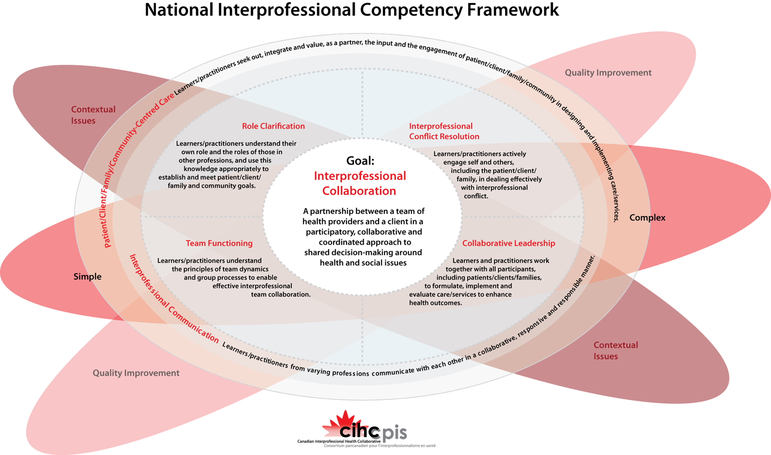
National Competency Framework for Interprofessional Collaboration (CIHC, 2010):

Slide 27
CIHC Framework
Domains:
Communication
Patient-focused Care
Role Clarification
Team Function
Interprofessional Conflict Resolution
Collaborative Leadership
Background:
Quality Improvement
Spiral complexity
Simple
Complicated
Complex
Context of Practice

Slide 28
UBC Model
UBC Model: Exposure, Immersion, Mastery
Exposure: knows about
e.g. shadowing,lectures and workshops
Immersion: knows how
e.g. interprofessional placement
Mastery: can teach
e.g. looked to an an excellent collaborator

Slide 29
A Framework for Interprofessional Education in Health Programs

Slide 30
A Framework for Interprofessional Education in Health Programs
Interprofessional Communication

Slide 31
A Framework for Interprofessional Education in Health Programs
Interprofessional Communication
Patient & Family Focused Care

Slide 32
A Framework for Interprofessional Education in Health Programs
Interprofessional Communication
Patient & Family Focused Care
Role Clarification

Slide 33
A Framework for Interprofessional Education in Health Programs
Team Function
Interprofessional Communication
Patient & Family Focused Care
Role Clarification

Slide 34
A Framework for Interprofessional Education in Health Programs
Collaborative Leadership
Team Function
Interprofessional Communication
Patient & Family Focused Care
Role Clarification

Slide 35
A Framework for Interprofessional Education in Health Programs
Collaborative Leadership
Team Function
Interprofessional Communication
Patient & Family Focused Care
Conflict Resolution
Role Clarification

Slide 36
A Framework for Interprofessional Education in Health Programs
Interprofessional Collaboration
Collaborative Leadership
Team Function
Interprofessional Communication
Patient & Family Focused Care
Conflict Resolution
Role Clarification

Slide 37
A Framework for Interprofessional Education in Health Programs
Residency/New Health Professionals
Complex
Interprofessional Collaboration
Collaborative Leadership
Clerkship/Fieldwork/ Practicum
Complicated
Team Function
Interprofessional Communication
Patient & Family Focused Care
Conflict Resolution
Clinical Clusters/ Academic Component
Simple
Role Clarification

Slide 38
A Framework for Interprofessional Education in Health Programs
Residency/New Health Professionals
Complex
Mastery
Interprofessional Collaboration
Collaborative Leadership
Clerkship/Fieldwork/ Practicum
Immersion
Complicated
Exposure
Team Function
Interprofessional Communication
Patient & Family Focused Care
Conflict Resolution
Clinical Clusters/ Academic Component
Simple
Role Clarification

Slide 39
A Framework for Interprofessional Education in Health Programs
Residency/New Health Professionals
Attitudinal Change
Complex
Mastery
Interprofessional Collaboration
Collaborative Leadership
Clerkship/Fieldwork/ Practicum
Immersion
Complicated
Exposure
Team Function
Interprofessional Communication
Patient & Family Focused Care
Conflict Resolution
Clinical Clusters/ Academic Component
Simple
Role Clarification

Slide 40
Conclusion
Health professionals must be educated in a multidisciplinary environment that will enhance communication and collaboration
Benefits include a greater potential for solving complex problems compared to any one profession acting alone (IOM, 2001)

Slide 41
QUESTIONS AND DISCUSSION

Slide 42
geeta@upm.edu.my

